Slide 1
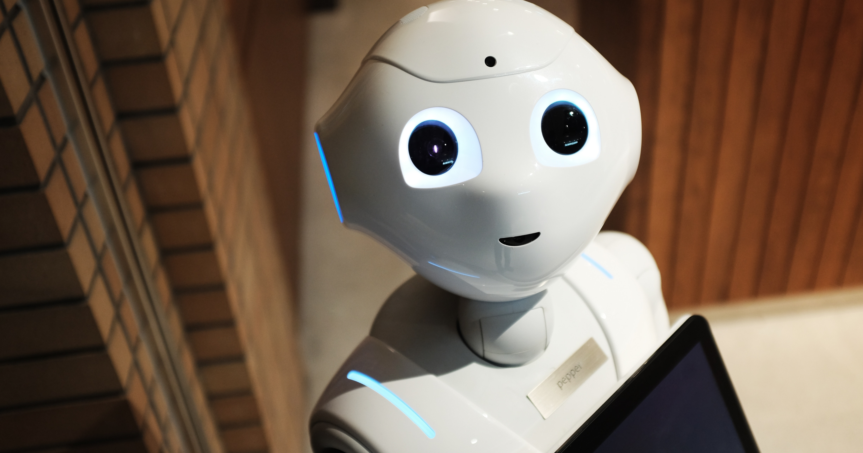



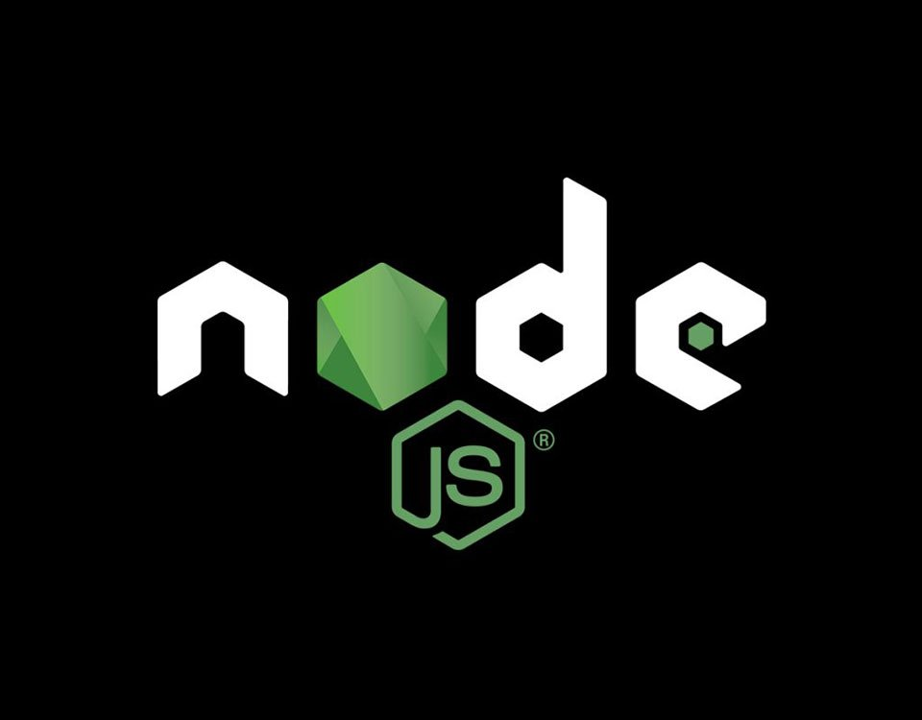

IPEC CHATBOT
A simple question-answering computer system for institutes
BASED ON IBM WATSON ,NODE.JS & EXPRESS.JS
Developed by:
Himanshi dhaiya
Nainish Aggarwal
Yash Mittal
Ujjwal Jain

